Slide 1
Department Guest Parking Permits

Slide 2
New Process Replacing the
Scratch-Off Guest Parking Permits
Parking Services is transitioning from the current scratch off guest permits moving to an online/URL website.
Program called Offstreet
Guests can preregister their vehicle prior to arriving on campus or can register when they arrive
Guests will receive a URL link or QR code and be assigned to use specific lots (PAY BY PLATE LOTS: 6, 14, 19, 29, 33, 39, 42, 51, 54, 62, 63, 66, 67, 79, 83, 89, 100, 102, 103, 112, 113, 311, 312)
The same URL link/QR code will be used for all guests during the fiscal year
Department can register on behalf of their guests
Changes to registration can be made up until day of event. Contact Parking Services at 517-355-8440
Cost per registration = $1.50/hour

Slide 3
Step by Step Guide for what Guests will see and need to do:
1. Click the link or type in the link into a search engine.
2. Enter plate number
a. Verify state of plate is correct
3. Next
4. Select the date you need to park
5. Select the time you will need to start parking
6. Next
7. Select the duration of time you need to park
8. Enter
9. Enter email address
10. Enter phone number
11. Park
12. Select send to email permit and parking instructions
13. Done

Slide 4
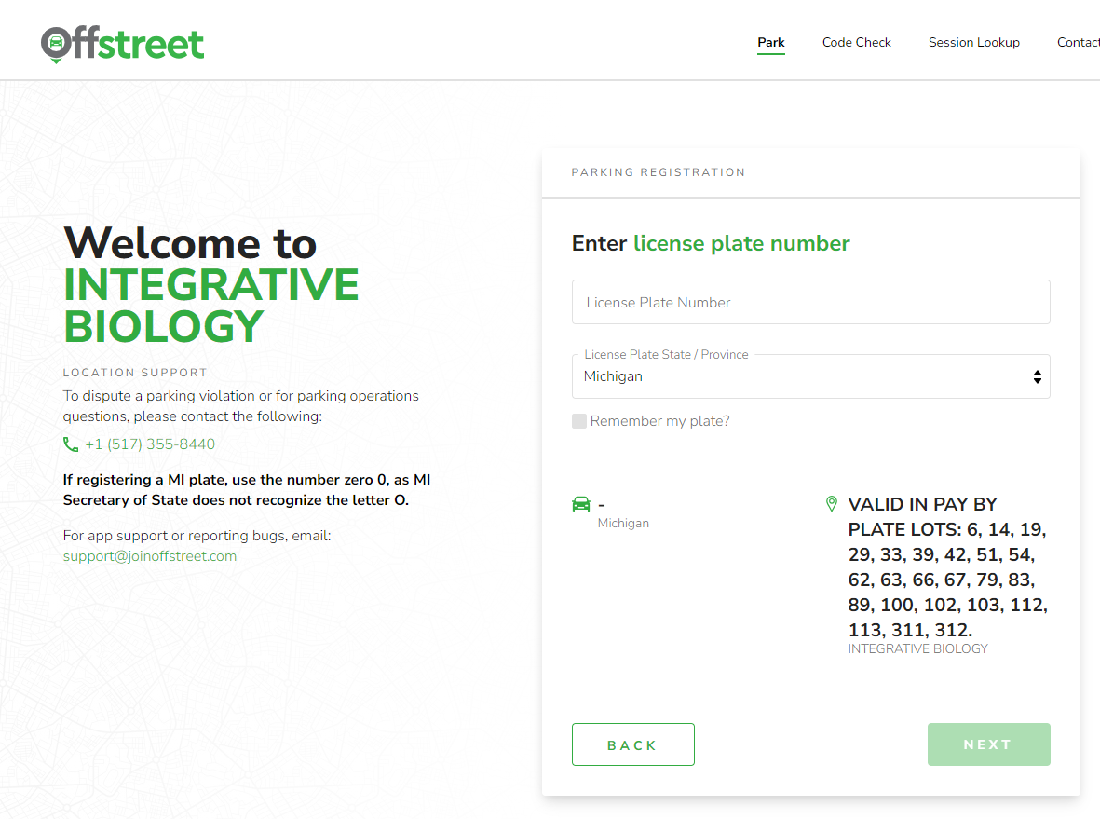

Slide 5
